Slide 1
CISC 4900 Project
Title: Analytical Dashboard Report for the Spread of Covid-19
By Steven Lin

Slide 2
Project Concept
Project Name: Analytical Dashboard Report for the Spread of Covid-19
Type of Project: Data Visualization & Analytics
Goal: Extensive Dashboard that will create a storyline for Covid data and help visualize metrics for better understanding.
Tools/Software Needed: Excel, Tableau, Git, Github, Jira

Slide 3
Supervisor Information
Supervisor Name: Troy Bailey
Title: Assistant Coordinating Manager
Location: NYC Health + Hospitals/Woodhull @ Admitting Department
Contact Information
Phone: (718)-964-7491
Email: baileyt12@nychhc.org
Mr. Bailey guides me with invaluable knowledge in the healthcare industry. His advice provides me an inside understanding of how the healthcare field works and techniques that are commonly used in this field to help my project stand out.

Slide 4
General Analysis Diagram
There is more factors that need to be tested for correlational analysis
Data set is processed
Correlational Analysis testing on factors presented in datasets
Cohort analysis
Cluster analysis
Cycle analysis
All datasets have been processed and correlated
Discard if relationship is not found
This diagram displays the general methodology behind the whole data analysis part of my project.
Two main portions:
The blue part represents the data processing and correlational analysis.
The green part represents the type of analyzations I could run after I have correlated and processed the data.
Report

Slide 5
Cohort Analysis Diagram
Analyze set of data by itself
No
Cohort Analysis
What is the nature of this analysis?
Is this analysis relational?
Group similar data points together to be analyzed
Yes
This diagram displays the methodology behind my cohort analysis. (This use to be my cluster analysis diagram. I originally mistaken cluster analysis for cohort analysis, vice versa.)
Types of cohorts used in my project so far:
Political Party
Month
Yes
Should it be analyzed with other data points that share similar traits?
No
Analyze set of data next to other sets of similar data

Slide 6
Map Chart
I wanted Map Charts to be a fundamental part of this projects. Map charts will be a key method in visualizing the datastory I want to portray.
Features/Chart(s) to Implement
Timeline Slider (Done)
From Jan 2020 to Dec 2020
Filterability with data (WIP)
State Details (WIP)
Alaska and Hawaii (WIP)

Slide 7
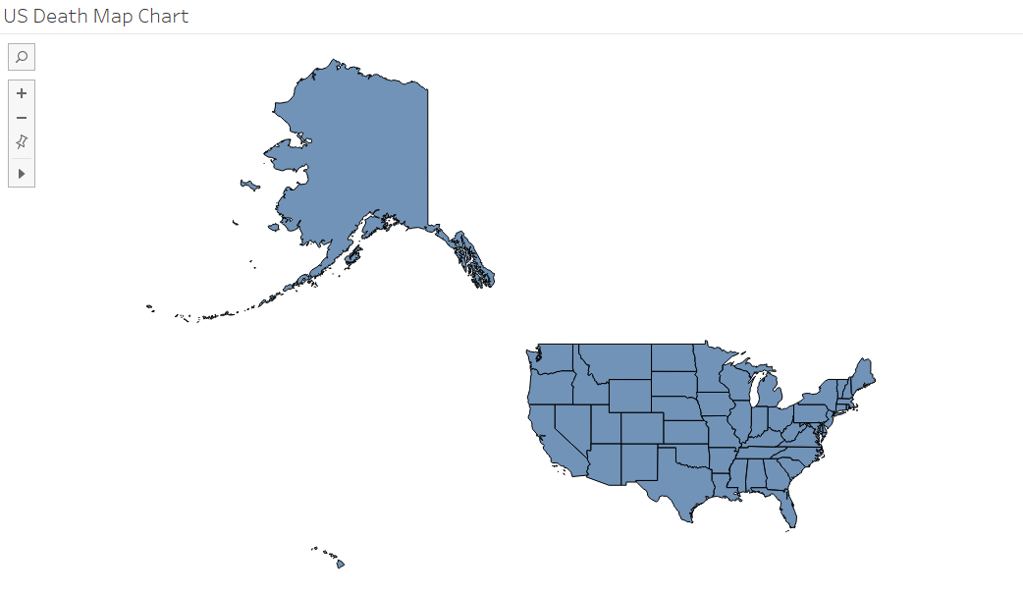
Alaska and Hawaii Map Chart Obstacle (WIP)
I am currently having difficulty scaling Alaska and Hawaii to proper sizes.
As you can see, Alaska is too big and Hawaii is too tiny. Looking to scale down Alaska while scaling up Hawaii a little bit.
One solution is that I may have to create different charts for Hawaii and Alaska but that creates conflicts when I design my dashboards.

Slide 8
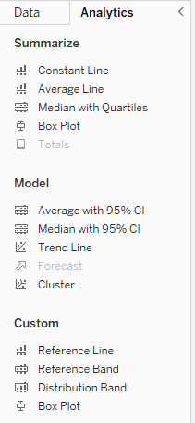
Data Analysis Journey
At the start of this project, I analyzed the data between fields by running them through Tableau Analytics functions somewhat randomly.
Realized it was not too efficient, so I started researching factors and methods that contribute to disease spread.
From there, I was able to infer which correlations were possible and ran Analytics on those perceived factors. This method was more efficient than the previous but can be still considered very brute forcey.
Still looking for other methods to make my correlational analysis more efficient. I lack proper expertise and knowledge in mathematical data analysis.

Slide 9
Dashboard Design Journey
Initially, my prototype design for my dashboard was congested and full of information that it was hard to pinpoint a central topic. (deleted the prototype before I started using Git, can be found in my demo recording)
To solve this problem, I discovered the Story function in Tableau.
This function allows me to group multiple dashboards together to create a “story”.
I was able to break down my prototype dashboard and can create a dashboard regarding a central topic which made data storytelling easier.
Currently, I have 4 dashboards that are WIP. (Airport to Infection, Total Monthly Death Toll, Economic Factors, Death Rates and Population Density by State)
The following 2 slides are samples of my improved upon versions of my prototype dashboards.

Slide 10
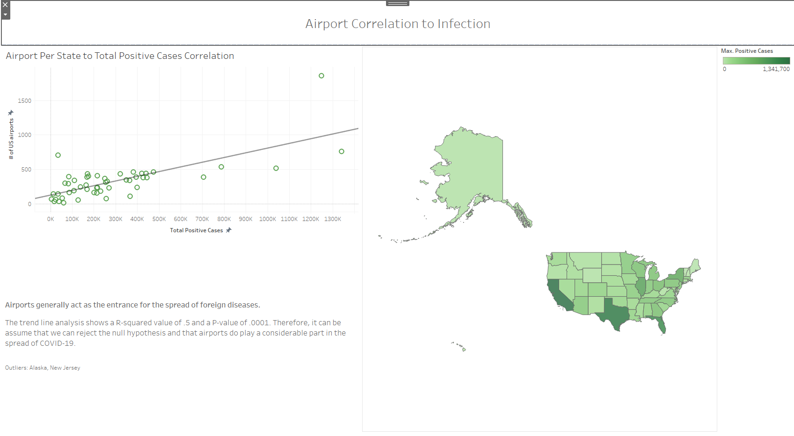
Airport Dashboard Sample
This is one of my dashboards I’ve created. The design is still in a very simple stage which will eventually be improved upon. This dashboard includes:
Interactive map chart that would filter the scatter plot graph and provide further details for each state.
Scatter plot graph representing # of US airports to Maximum Covid Cases per state.
A text box to help represent the story.

Slide 11
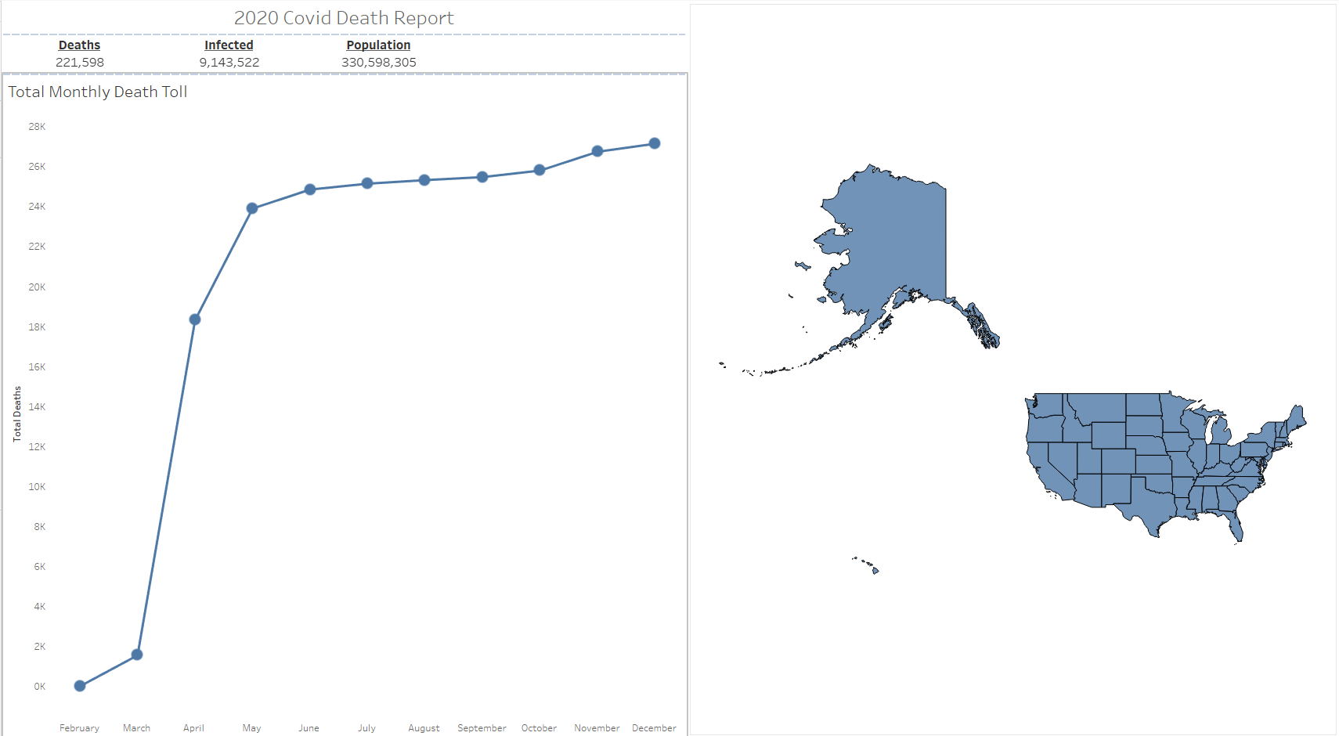
2020 Covid Death Report Dashboard Sample
This sample dashboard showcases the deaths/infected/population metrics and a plot graph of the death count through the months of each state. Looking to improve upon the UI of this dashboard. This dashboard includes:
Interactive map that filters metrics and graph for that specific state.
Plot graph that is filterable.
Key metrics that is relevant to the dashboard central topic.

Slide 12
Update on Time Logs
For the most part, I have been averaging 30 hours per 2 weeks with one expectation.
Due to personal circumstances, for the weeks of 10/1-10/14, I could not meet the 30 hour requirement. Other than those two weeks, I have met the requirements.
I tend to try to do majority of my project towards the weekend as they tend to be the days where I have the most time.
Structurally, my time logs are still Date, Duration, Type, Description, Challenges/Results.
I was able to create one workbook to store all my time sheets.

Slide 13
Hurdles/Difficulties
Learning what Tableau can do
Tableau offers many tools of data visualization. It took an extensive amount of time figuring out what I needed Tableau to do for me.
Understanding of Data fields in Data sets
Realized in multiple different instances that I was using certain data fields improperly. As you can imagine, it was a pain reorganizing when that occurred.
Data Correlation between Data sets
Had a hard time finding logical efficient methods to determine which factors should be analyze between data sets. Had to result to brute force checking relationships that were not clearly obvious.
Lack of Expertise
I lack experience when it comes to data analytics. Outside of one statistic course, I did not have much experience in terms of mathematical data analysis. Had to refer to Google a lot in this portion of my project.
Finding the right data sets (Everything is on the internet until you look for it)
Kaggle is either a hit or miss. Eventually, I found that CDC.gov also had great datasets (Thanks Troy!).

Slide 14
Future Implementations
Cycle Analysis
Cluster Analysis (maybe)
More dashboards to add unto the Story
Further details on dashboards
Improve visual structure of dashboards
Deployment

Slide 15
Links
Jira Project Board:
https://bcmail-project-cisc4900.atlassian.net/jira/software/projects/SCRUM/boards/1/timeline?shared=&atlOrigin=eyJpIjoiYjBkOTE5ZGMxODE0NDkzN2E2Y2NlNmZjZGZkNTlmYzQiLCJwIjoiaiJ9
Github Repo:
slin0725/CISC-4900-Project

